Slide 1



Unconstrained Monotonic Calibration of Predictions in Deep Ranking Systems
USTC & Kuaishou Technology
Yimeng Bai, Shunyu Zhang,Yang Zhang, Hu Liu, Wentian Bao, Enyun Yu, Fuli Feng, Wenwu Ou
Notes:
Hello everyone, I am Shunyu Zhang from Kuaishou. I am glad to be here to present our paper Unconstrained Monotonic Calibration of Predictions in Deep Ranking System.

Slide 2
Outline
  Background: Calibration Challenge & Existing Work
  Method: ﻿ Unconstrained Monotonic Calibrator & Calibration-aware Learning Strategy.
  Experiments: ﻿Comparison Results, Ablation Study and Online A/B Tests.
  Conclusion and Highlights.
02/17
Notes:
Today my presentation consists of four parts:​ first, the background including the calibration challenge in ranking systems and existing work. Second,our proposed methodology. Third, the experiments and detailed results. And finally, the Conclusion and Highlights.

Slide 3






Background
What is Calibration
Ranking system learns matching scores to sort candidates.
User
Item
Query
Document
Main focus: relative order
Recommendation
Search
Higher score, greater relevance
Accurate absolute values are essential for certain downstream tasks
Expected Revenue (ER) = predicted Click-Through Rate (pCTR) × price
pCTR=0.8 → ER=8000
pCTR=0.9 → ER=9000
Assume price=10000,
Advertisement bidding
$∆$pCTR=0.1 leads to $∆$ER=1000 !!!
03/17
Notes:
First I will introduce the background. The modern ranking systems power nearly every digital experience we interact with—from search engines to recommendation feeds. These ranking systems learn matching scores to sort candidates, where a higher score typically indicates greater relevance. However, while ranking focuses on relative order, many downstream tasks—like advertisement bidding—depend on accurate absolute values. For example, in ads bidding, expected revenue is calculated as predicted CTR multiplied by price. A small error in CTR prediction can lead to significant revenue loss.

Slide 4

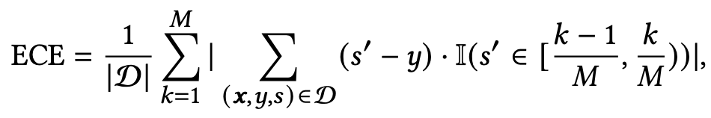
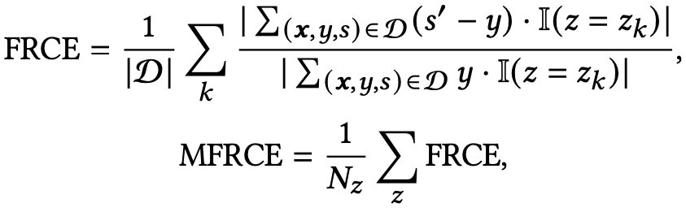


Background
How to Do Calibration
Learn a calibrator model for adjustment
$$(x,y,s)$$
Feature
Label
Score
User, Item,…
Binary
0/1,
is_click
Prob.
[0,1],
pCTR
Actual Prob.
Calibrated
Prediction
Calibrator
unobservable
    Expected Calibration Error (ECE)
    Field Relative Calibration Error (FRCE)
    Multi-Field Relative Calibration Error (MFRCE)
Calibration metrics for evaluation
  We need the estimation of ground-truth P(y=1|x)
Split samples into different buckets.
Score range (eg, pCTR $∈[0.2, 0.4]$)
Feature Field (eg, gender==man)
04/17
Notes:
So we need calibration to adjust raw model outputs to align with real-world probabilities. To do this, we typically learns a calibrator model to transform the outputs. Given the sample features and the raw predicted scores, the calibrator aims to align the original predictions with actual probabilities through adjustments.
To evaluate the calibration metrics, we need the estimates of actual probabilities. However, the actual probability of the given sample is unobservable. So the widely adopted metrics such as ECE and FECE split samples into different buckets by score range or feature field, and then calculate the mean error for each bucket.

Slide 5
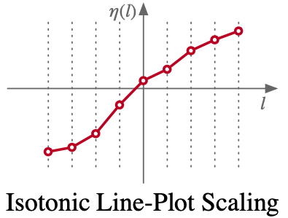

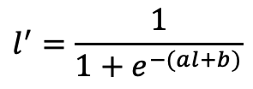
Background
Existing Work on Calibration
Common process：
  Order-preserving transformation to ensure the sorting unaffected.
Existing work: Fixed-form Calibrations and DNN-based methods
Fixed-form Calibration
  Platt scaling: learn a logistic regression function.
  Binning: Split samples into different bins and
  statistically decide linear coefficients for each bins.
Limitation: Limited learnable parameter space
$$l^{′}=\frac{1}{1+e^{−(al+b)}}$$
$$l^{′}=Binning\left(l\right)$$
05/17
Notes:
Calibration methods typically employ order-preserving transformations to learn calibrators. Existing work falls into two categories: fixed-form calibrations and deep neural network (DNN)-based methods. Typical fixed-form calibration methods include Platt scaling and Binning. However, these methods suffer from constrained learnable parameter spaces, limiting their expressive power and adaptability/əˌdæptəˈbɪləti/ to complex data distributions.

Slide 6



Background
Existing Work on Calibration
DNN-based transformation
  FAC (WWW’20): add DNN bias
  SBCR (KDD’24): learn DNN-based linear coefficients
  DESC (KDD’24): learn DNN-based weights of basis functions
Limitation
  Excessive constraints: Most adhere to piece-wise linear
    Fail in complex scenarios like multi-field calibration
    Amplify value errors in specific fields within feedback loops
Motivation: reduce constraints on the architecture for full potential
$$l^{′}=Binning\left(l\right)+DNN(x)$$
$$l^{′}={Binning}_{DNN}\left(l,x\right)$$
$$l^{′}=w_{DNN}\left(x\right)⋅𝓑(l)$$
06/17
Notes:
Another line of work is DNN-based calibration methods, such as the FAC, SBCR, and DESC. These methods enhance calibration performance through carefully designed DNN architectures. However, they suffer from a major limitation: excessive constraints. Most of them rely on piece-wise linear transformations, which fail in complex scenarios such as multi-field calibration and risk amplifying errors in feedback loops. Our goal is to relax these constraints and unlock the full potential of calibration models.

Slide 7
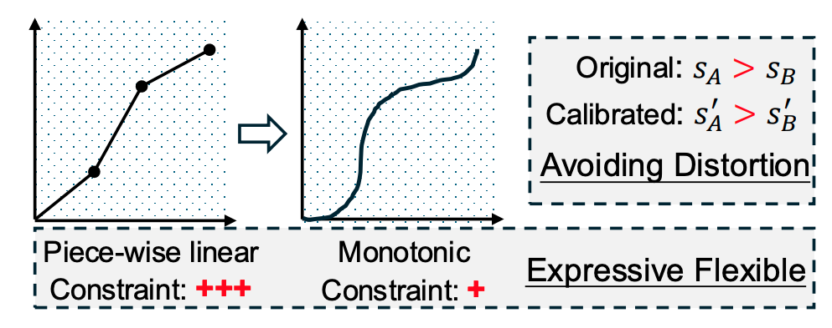
Methodology
How to Reduce Constraints
Core idea
  Piece-wise linear = linear + monotonic
  A more general form: only monotonic
How to design monotonicity
  UMNN [1] is the answer
  Key: if a function is differentiable, its derivative being single-sign is a necessary and sufficient condition for the function to be monotonic
  How: construct a single-sign function for a learnable network and do integral computation
[1] Unconstrained Monotonic Neural Networks. NeurIPS 2019.
07/17
Notes:
To address these limitations, we propose to relax constraints. Traditional calibrators enforce piece-wise linear to maintain monotonicity
/ˌmɒnətəˈnɪsətɪ/, which limits their flexibility. In fact, a more general form fundamentally only needs to be monotonic. Thus, we focus on monotonicity—a weaker but critical constraint ensuring that higher raw scores correspond to higher calibrated scores and avoiding rank distortion. How do we model this? The answer is Unconstrained Monotonic Neural Networks (UMNN for short). UMNN guarantees monotonicity by constructing differentiable/ˌdɪfəˈrenʃɪəb(ə)l/ functions with single-signed derivatives/dɪˈrɪvətɪvz/: it first builds a single-signed function for a learnable network, then computes integral transformations.

Slide 8
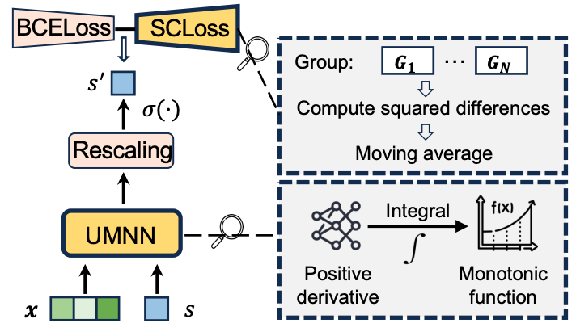
Methodology
Overall Framework of UMC
Monotonic Calibrator
  UMNN(Unconstrained Monotonic Neural Networks)
    learnable NN and ensure monotonic
  Feature-aware Rescaling method
Calibration-aware Learning Strategy
  BCELoss: common setting
  SCLoss (Smooth Calibration Loss)
    directly optimizing calibration aspect
08/17
Notes:
Next, let’s dive into our proposed framework: UMC. It consists of two core components: a Monotonic Calibrator and a Calibration-aware Learning Strategy. The Monotonic Calibrator leverages UMNN to learn monotonic functions with Feature-aware Rescaling, while the novel SCLoss directly optimizes calibration objectives.

Slide 9
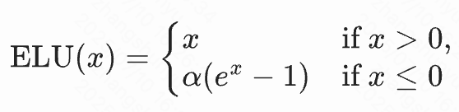




Methodology
Monotonic Calibrator Architecture
UMNN
  MLP with positive outputs
  Compute integral based on specific algorithm (﻿using the static Clenshaw–Curtis quadrature algorithm).
  Monotonicity is ensured by
Original logit
Rescaling
  Features 𝒙 are fed into a distinct MLP module
  Compute a feature-specific rescaling factor 𝑤(𝒙) and bias term 𝑏(𝒙).
  Enhance the overall network learnability and preserve monotonicity.
09/17
Notes:
This slide is the details of the Monotonic Calibrator Architecture. It’s built on UMNN Backbone: An MLP with positive outputs, whose positivity is guaranteed by the ELU activation function. And then compute integrals to ensure monotonic, via a specific numerical/njuːˈmerɪk(ə)l/ integration algorithm. Next, we introduce Feature-aware Rescaling: a separate MLP takes sample features as input to generate sample-specific scaling factors and biases. this design enhances learnability from the sample features while preserving monotonicity. Finally, the calibrated score is produced by applying a sigmoid transformation to the rescaled UMNN output.

Slide 10
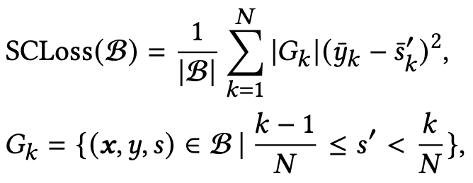
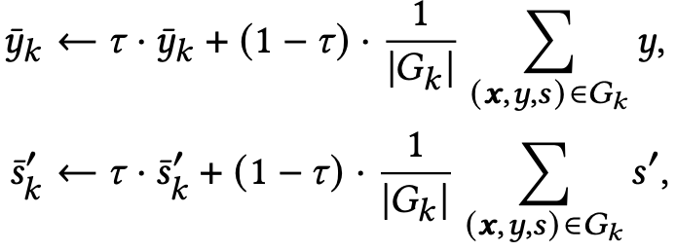

Methodology
Calibration-aware Learning Strategy
SCLoss
  Computation
    Discretize the interval into 𝑁 equal-width bins
    Group samples by bins calibrated predictions fall into
    Compute the squared differences per bin
    Take a weighted average based on the group size.
  Moving average technique
    Smooth by keeping a fraction of values
    from the previous batch.
Overall Loss
10/17
Notes:
To optimize for both ranking and calibration, we introduce the Smooth Calibration Loss (SCLoss). Unlike standard BCE loss, SCLoss first discretizes/dɪˈskriːtaɪz/ the predictions into bins by grouping samples by their calibrated scores, then computes mean squared errors per bin to focus on calibration quality. Additionally, we propose using moving averages to smooth batch-wise noise, ensuring stable and robust training. The total loss function combines BCE loss and SCLoss to balance these two objectives.

Slide 11
Experiment
Offline Experiment Setting
Dataset
  CTR dataset: Avazu, AliCCP
Evaluation
  Ranking: AUC, GAUC
  Calibration (main focus): ECE, FRCE, MFRCE
Baseline
  Fixed-form method: Uncalib, HistBin, IsoReg, SIR, Platt, Gauss
  DNN-based method: FAC, SBCR, DESC
Pipline
  Train a DeepFM model, then train a calibrator model to calibrate predictions
11/17
Notes:
We evaluated UMC in both offline and online settings, yielding comprehensive results. The datasets include CTR prediction tasks on Avazu and AliCCP. Metrics include AUC and GAUC for ranking, and ECE, FRCE, MFRCE for calibration. Baselines include Fixed-form methods and DNN-based methods. For offline experiments, we train the calibrator on top of the DeepFM model to ensure fair comparison.

Slide 12
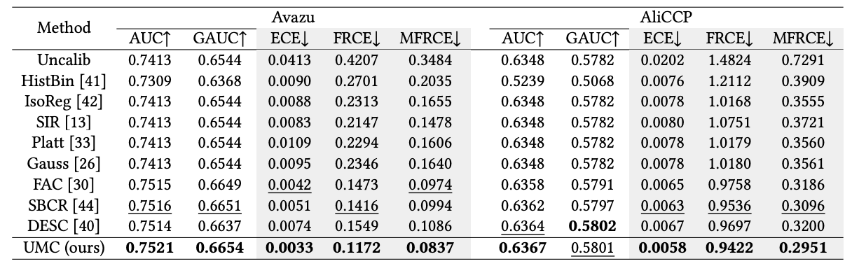
Experiment
Offline Experiment Result
Calib > Uncalib: calibration is necessary for ranking models.
DNN-based > Fixed-form method: enhanced model capacity.
UMC > Baselines: expressive calibrator & calibration-aware learning.
12/17
Notes:
From the offline results, we draw three key findings: First, the calibrated methods outperform uncalibrated baselines—confirming calibration is critical for ranking models. Second, DNN-based methods outperform Fixed-form methods for their enhanced model capacity. traditional approaches like Platt scaling or binning rely on rigid and simple formulas, while DNN-based methods have the capacity to learn complex patterns. Third, UMC outperforms all baselines on calibration metrics, which demonstrates the effectiveness of monotonic calibrator and calibration-aware learning.

Slide 13
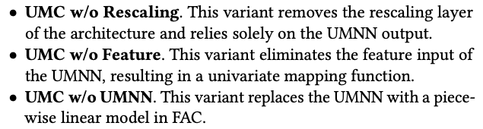
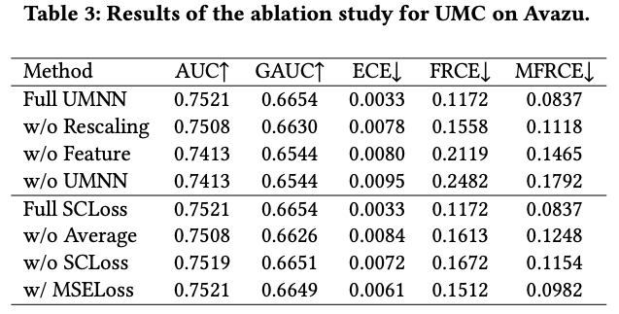
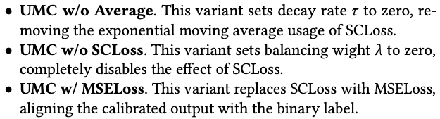
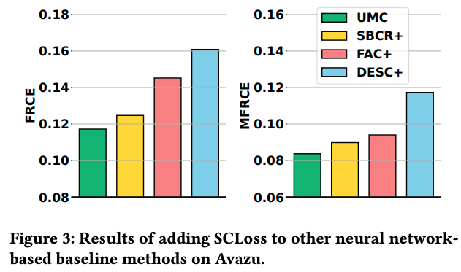
Experiment
Ablation Experiment Result
Both UMNN and SCLoss designs are effective.
UMNN forms the foundation and achieves higher gains.
SCLoss can be generally applied to baselines.
13/17
Notes:
In the ablation studies, we validated the necessity of UMC’s key components. Our results show both UMNN and SCLoss are critical: removing either of them would degrade calibration performance. As shown in the table, UMNN served as the foundation, delivering greater performance gains, while SCLoss was equally essential—disabling SCLoss significantly degraded calibration performance. Notably, adding SCLoss to other strong baselines including FAC and SBCR also improved their calibration metrics, demonstrating SCLoss can generalize to other models.

Slide 14
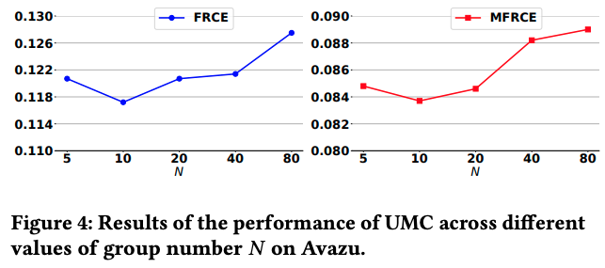
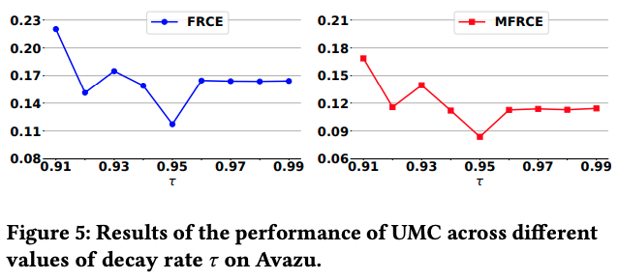
Experiment
Hyper-parameter Experiment Result
Group number $N$ in SCLoss
1. Insufficient numbers diminishes the ability to differentiate among groups.
2. Excessive numbers can lead to bins with sparse data, rendering the computation unreliable.
Decay rate $τ$ in SCLoss
1. Too small values lead to a delayed response to recent batch data.
2. Too large value obscure long-term trends.
14/17
Notes:
Next is hyperparameter experiments for SCLoss. First, group number N: too small, hard to tell groups apart; too large, sparse bins make results unreliable. And the charts show the number of 20 works best. For decay rate: too small values lead to a delayed response to recent batch data; and too large obscures long-term trends. We found the suitable hyper-parameters achieve better balance and yield optimal results.

Slide 15
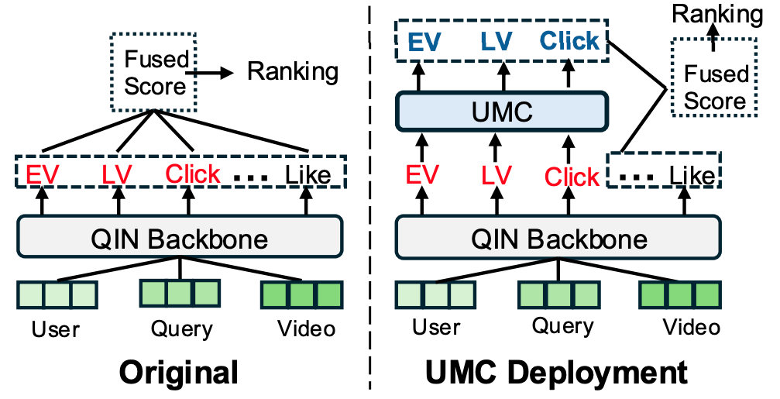
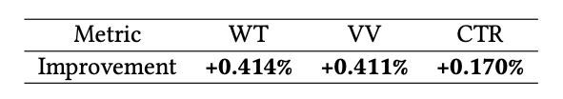
Experiment
Online Experiment Result
Kuaishou Video Search System
  Backbone: QIN[2] as the industry baseline.
  Method: replace the original predictions of Click, EffectiveView, LongView in the fused score.
  Scale: 5% (20 million users)
  AB Time: one week
  Metrics: total watch time (WT), effective video views (VV) and click-through rate (CTR)
  Note: efficient deployment without introducing significant computational overhead.
[2] Query-dominant User Interest Network for Large-Scale Search Ranking. CIKM 2023.
15/17
Notes:
We also conducted an online experiment. We deployed UMC on Kuaishou video search system. We replaced the original Click, EffectiveView, and LongView predictions in the fused ranking score with UMC-calibrated ones, using QIN as the industry baseline backbone. The A/B test served 20 million users over one week.
As shown in the table, UMC achieved significant gains across key metrics including total watch time, effective video views, and CTR . And crucially, this came with no significant computational overhead—making UMC ready for large-scale deployment. Today, UMC has been rolled out to 100% of traffic, serving hundreds of millions of daily user requests and delivering a better user experience.

Slide 16
Conclusion
Unconstrained Monotonic Calibration in Ranking
Challenge: excessive calibrator constraints.
Motivation: relax constraints to a more generalizable form.
Methodology
  Monotonic Calibrator Architecture (UMNN)
  Calibration-aware Learning Strategy (SCLoss)
Offline experiments demonstrate the superior performance of UMC.
Online A/B test shows significant gains on Kuaishou video search platform.
16/17
Notes:
To conclude, we addressed the challenge of excessive constraints in ranking calibration by relaxing these constraints to enable a more generalizable form. Our solution, UMC, integrates two key innovations: a Monotonic Calibrator Architecture using UMNN, and a Calibration-aware Learning Strategy with SCLoss. Offline experiments demonstrated UMC’s superior performance over baselines, while the online A/B test on Kuaishou video search platform showed significant gains in key metrics. Together, these results validate UMC as an advanced calibration solution for real-world ranking systems.

Slide 17

Thanks
The code has been released at
https://github.com/baiyimeng/UMC
17/17

