Slide 1


Distributionally Robust Optimization for Unbiased Learning to Rank
Zechun Niu¹, Lang Mei², Chong Chen², Jiaxin Mao^{1*}
¹Renmin University of China, ²Huawei Cloud BU
niuzechun@ruc.edu.cn, maojiaxin@gmail.com
2025.07

Slide 2
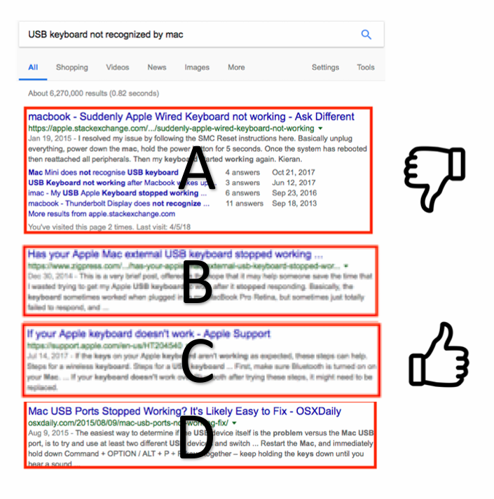
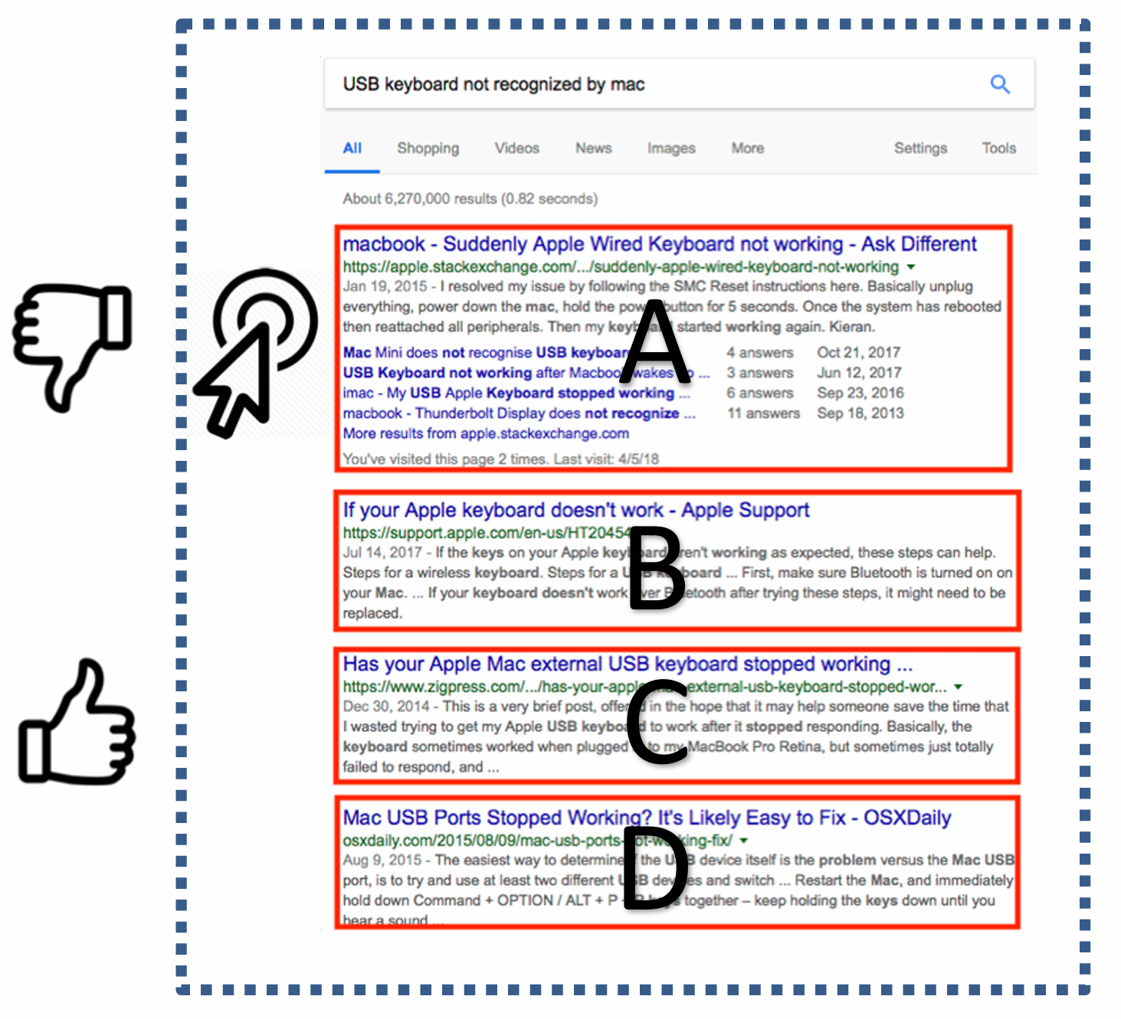
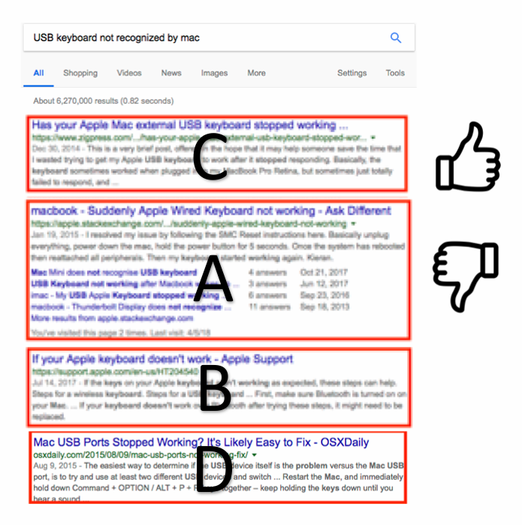
Background
Users’ interactions with search systems (e.g. clicks) can reflect their relevance feedback for search results and are easy to collect.
However, clicks are also noisy and biased, so directly using clicks to train ranking models is suboptimal.
Unbiased Learning to Rank (ULTR): learning an unbiased ranker from biased user click logs
User interactions
Ranking models
Naive
SVMrank
Ranking results
LambdaMART
DNN
ULTR
……

Slide 3
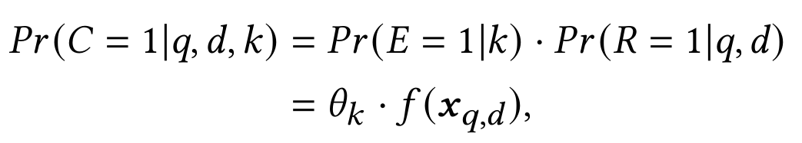
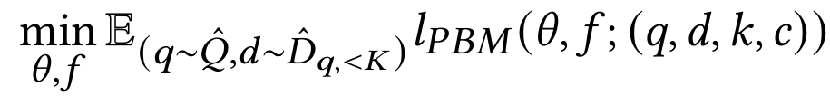
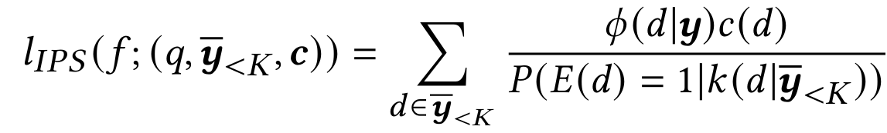
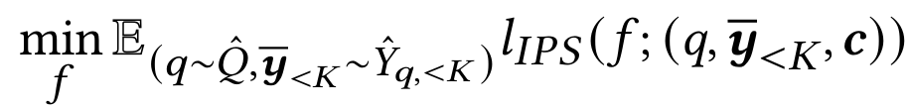
Background
Two branches of existing ULTR models:
  Click modeling: modeling and optimizing the click probabilities of the query-document 𝑞-𝑑 pairs in a pointwise manner
  Counterfactual learning to rank: minimizing unbiased estimates of listwise ranking loss with inverse propensity scoring (IPS)

Slide 4
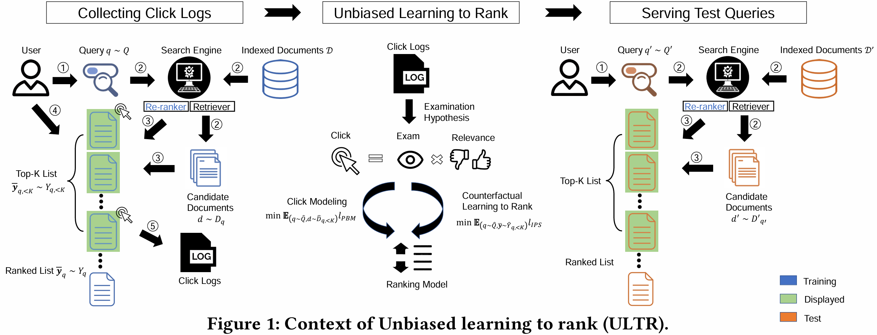
Background
The existing ULTR methods focus on mitigating biases in clicks, but they overlooked the intrinsic distribution shifts between the training and test data.

Slide 5
Background
Distribution shifts can come from three aspects:
  (1) Query frequency: users’ query preferences change as time goes by and popular topics vary, so the frequency of the test queries 𝑞′ ∼ 𝑄′ is different from that of the training queries 𝑞 ∼ 𝑄.

Slide 6
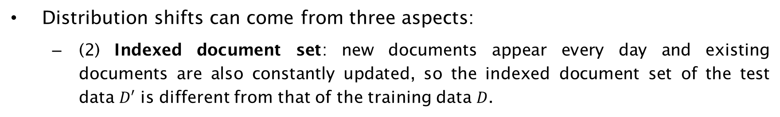
Background
Distribution shifts can come from three aspects:
  (2) Indexed document set: new documents appear every day and existing documents are also constantly updated, so the indexed document set of the test data $D′$ is different from that of the training data $D$.

Slide 7
Background
Distribution shifts can come from three aspects:
  (3) Number of candidate documents: a session log in the training data contains only the top-𝐾 documents returned by the online production ranker, while the test data contain all the candidate documents returned by the retriever.

Slide 8
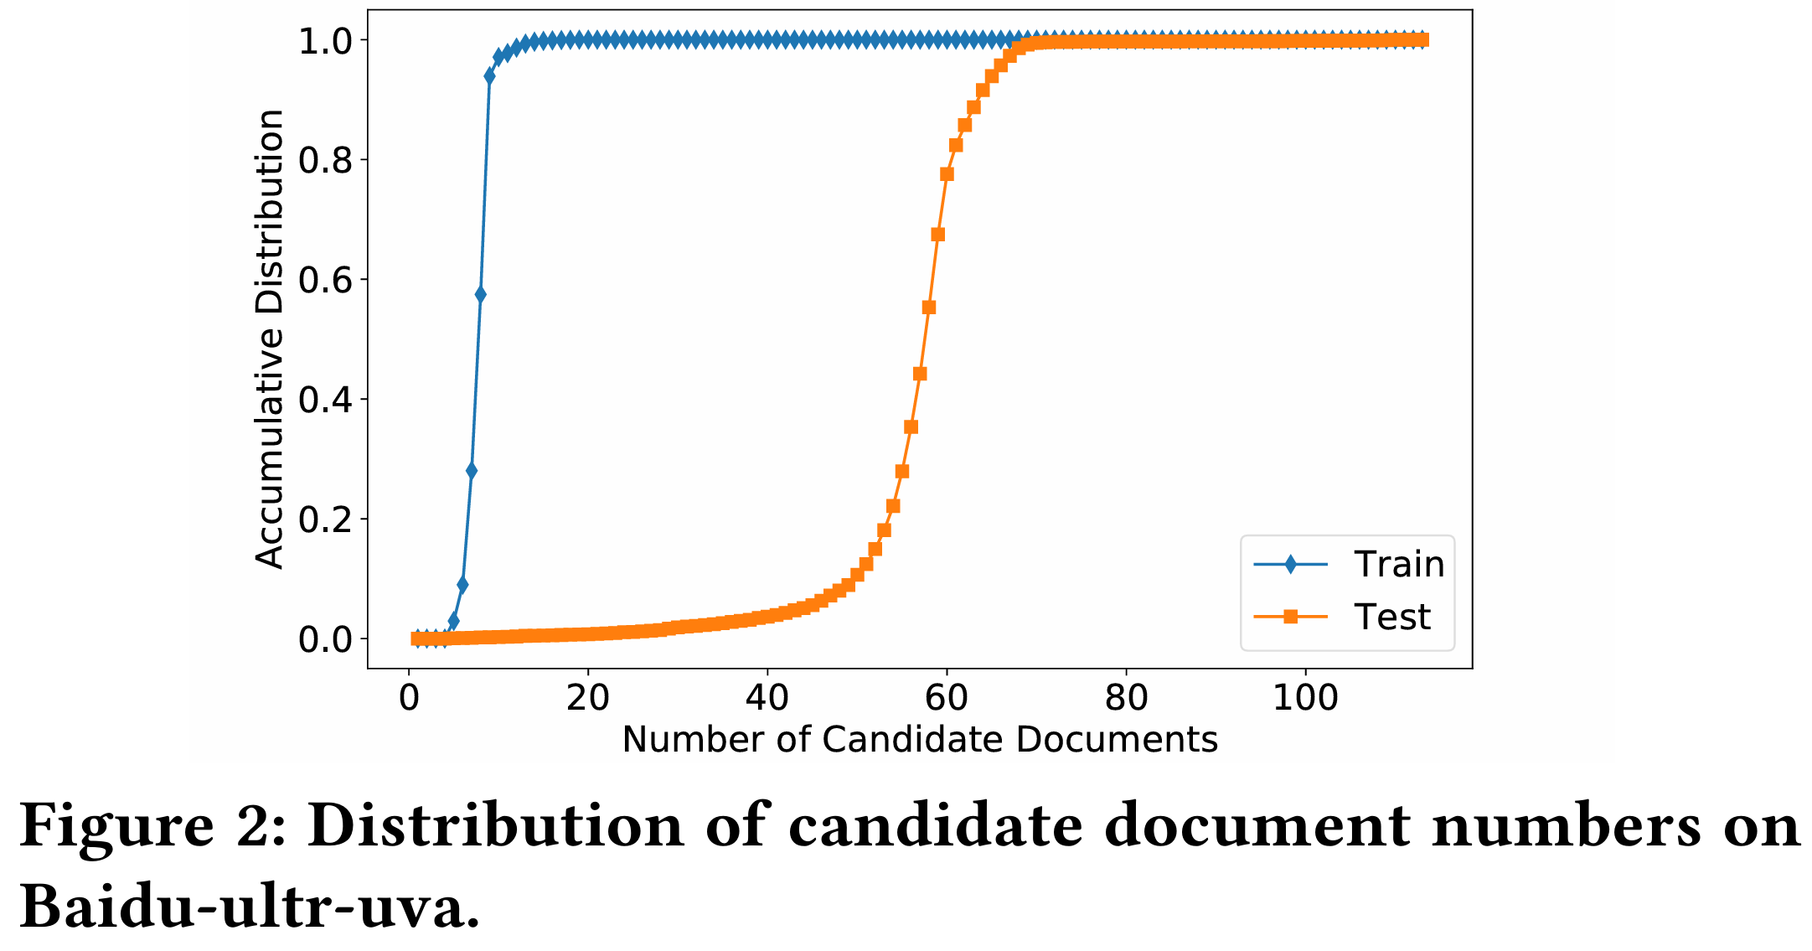
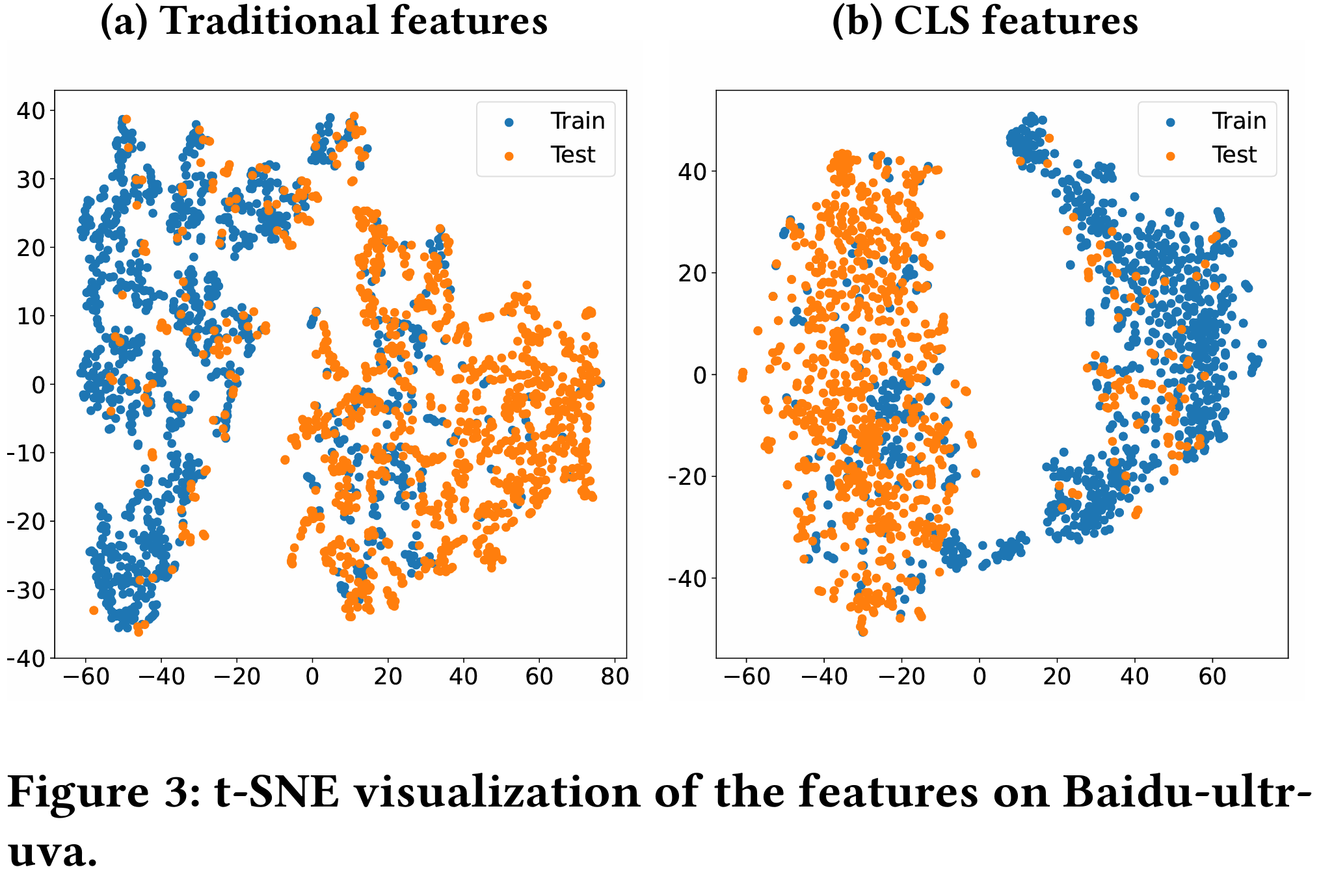
Distribution Shifts in a Real-world ULTR Dataset
Baidu-ultr-uva dataset:
  A real-world dataset collected from a large commercial search engine, Baidu.com
  https://huggingface.co/datasets/philipphager/baidu-ultr_uva-mlm-ctr
  The training and test data are sampled from search traffic in different periods.

Slide 9
Distributionally Robust Unbiased Learning to Rank
Since the test distribution of ULTR is constantly changing over time and is unknown at the training time, the domain transfer learning methods, such as instance reweighting and feature alignment, can not be used to solve the distribution shift problem.
Our main idea is to introduce the group distributionally robust optimization (group-DRO) algorithm into the existing ULTR methods to enhance their robustness to distribution shifts.
  Different from empirical risk minimization (ERM) that follows the I.I.D. assumption, DRO minimizes the training loss under the worst-case distribution at each step.
  Specifically, we design two group distributionally robust optimization (group-DRO) frameworks for the existing ULTR methods, one using the pointwise click prediction loss and the other using the listwise counterfactual ranking loss.

Slide 10

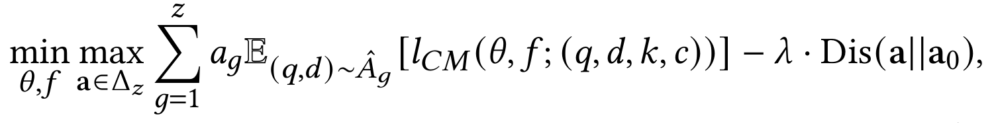
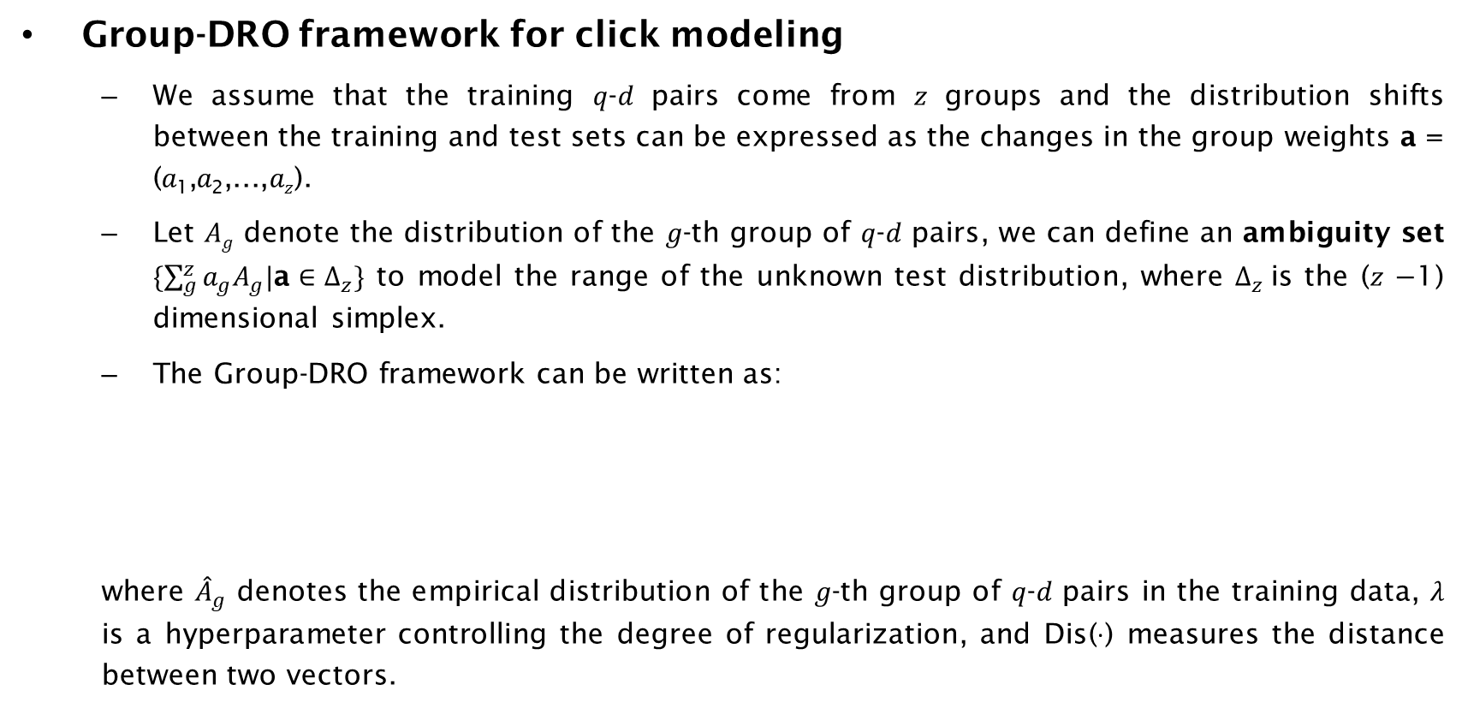
Distributionally Robust Unbiased Learning to Rank for Click Modeling
Group-DRO framework for click modeling
  We assume that the training 𝑞-𝑑 pairs come from 𝑧 groups and the distribution shifts between the training and test sets can be expressed as the changes in the group weights a = (𝑎₁,𝑎₂,...,𝑎_{𝑧}).
  Let 𝐴_{𝑔} denote the distribution of the 𝑔-th group of 𝑞-𝑑 pairs, we can define an ambiguity set $\{\sum_{g}^{z}{a_{g}A_{g}\text{|}\text{a}}∈∆_{z}\}$ to model the range of the unknown test distribution, where $∆_{z}$is the (𝑧 −1) dimensional simplex.
  The Group-DRO framework can be written as:
  where ${\hat{A}}_{g}$ denotes the empirical distribution of the 𝑔-th group of 𝑞-𝑑 pairs in the training data, 𝜆 is a hyperparameter controlling the degree of regularization, and Dis(·) measures the distance between two vectors.
Remind that the traditional CM loss is:

Slide 11

Distributionally Robust Unbiased Learning to Rank for Click Modeling
Clustering Based on Query-document Feature
  Because we lack golden relevance labels or type labels for the training data in ULTR, how to group the training samples becomes a challenge.
  Inspired by Yu et al. [1], we utilize clustering to group training samples based on the given features.
  To group the training 𝑞-𝑑 pairs, we simply perform K-Means clustering on their features x_{𝑞,𝑑} to obtain 𝑧 cluster centers {v_{𝑔}|𝑔 ∈ (1,2, ...,𝑧)}. Then, we assign group labels 𝑔 with:
[1] Yu et al. 2022. COCO DR: Combating Distribution Shift in Zero-Shot Dense Retrieval with Contrastive and Distributionally Robust Learning. EMNLP.

Slide 12
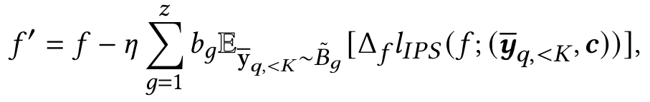
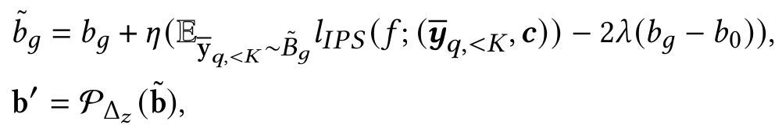
Distributionally Robust Unbiased Learning to Rank for Click Modeling
Efficient Optimization
  To efficiently optimize the DRO-ULTR methods, we follow Qian et al. [2] to solve the min-max problem iteratively with mini-batch samplings.
  At each step, we randomly sample a mini-batch 𝑛 of examples from the click logs. Taking DRO-CLTR as example, the ranking model is updated with the reweighted examples using stochastic gradient descent (SGD):
  The group weights are updated using gradient ascent
[1] Qian et al. 2020. Hierarchically robust representation learning. CVPR.

Slide 13
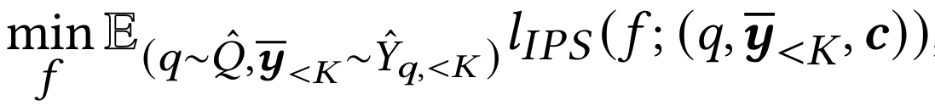
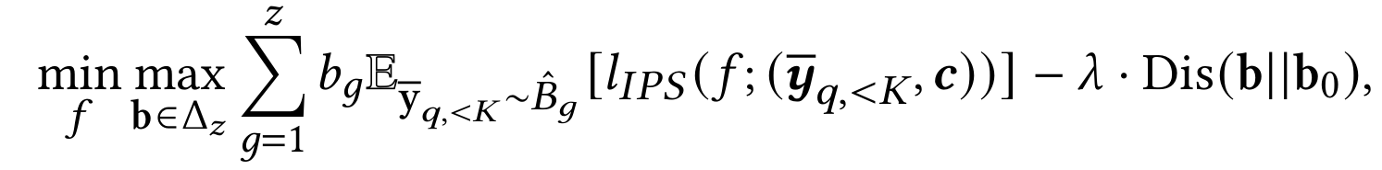
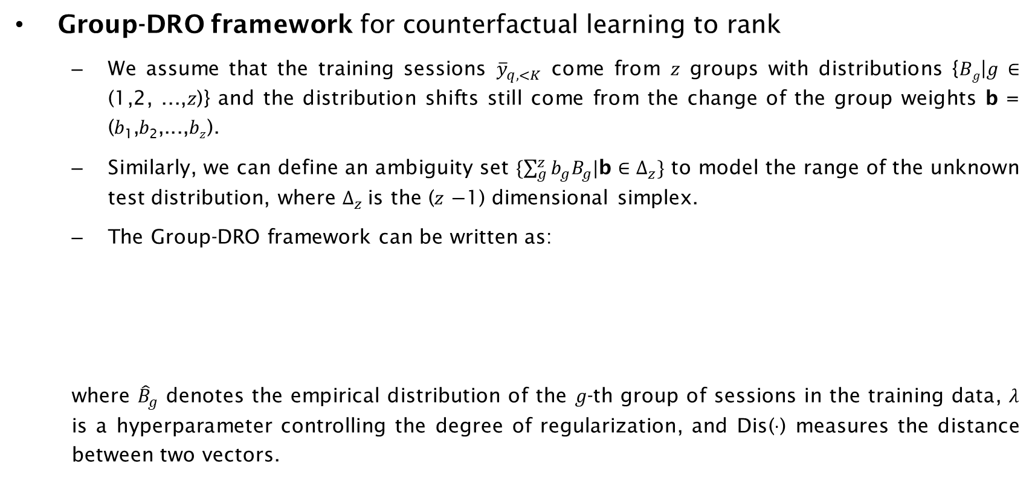
Distributionally Robust Unbiased Learning to Rank for Counterfactual Learning to Rank
Group-DRO framework for counterfactual learning to rank
  We assume that the training sessions ${\overline{y}}_{q,<K}$ come from 𝑧 groups with distributions {𝐵_{𝑔}|𝑔 ∈ (1,2, ...,𝑧)} and the distribution shifts still come from the change of the group weights b = (𝑏₁,𝑏₂,...,𝑏_{𝑧}).
  Similarly, we can define an ambiguity set $\{\sum_{g}^{z}{b_{g}B_{g}\text{|}\text{b}}∈∆_{z}\}$ to model the range of the unknown test distribution, where $∆_{z}$is the (𝑧 −1) dimensional simplex.
  The Group-DRO framework can be written as:
  where ${\hat{B}}_{g}$ denotes the empirical distribution of the 𝑔-th group of sessions in the training data, 𝜆 is a hyperparameter controlling the degree of regularization, and Dis(·) measures the distance between two vectors.
Remind that the traditional CLTR loss is:

Slide 14
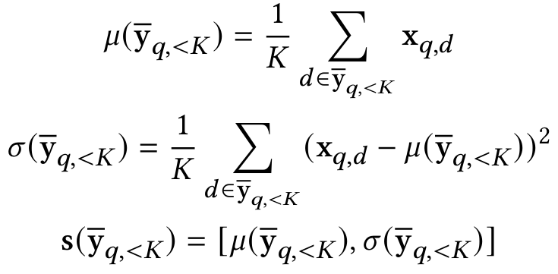

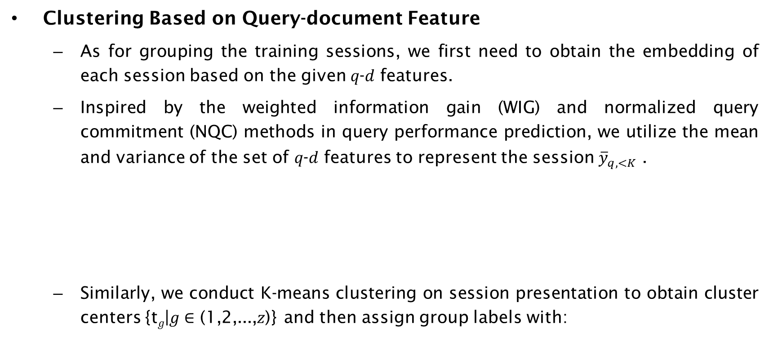
Distributionally Robust Unbiased Learning to Rank for Counterfactual Learning to Rank
Clustering Based on Query-document Feature
  As for grouping the training sessions, we first need to obtain the embedding of each session based on the given 𝑞-𝑑 features.
  Inspired by the weighted information gain (WIG) and normalized query commitment (NQC) methods in query performance prediction, we utilize the mean and variance of the set of 𝑞-𝑑 features to represent the session ${\overline{y}}_{q,<K}$ .
  Similarly, we conduct K-means clustering on session presentation to obtain cluster centers {t_{𝑔}|𝑔 ∈ (1,2,...,𝑧)} and then assign group labels with:

Slide 15
Experimental Setup
Dataset: Baidu-ultr-uva
Baselines:
  Pointwise: Pointwise-Naïve, PBM, Regression-EM, Vectorization
  Listwise: Listwise-Naïve, IPS-PBM, DLA, Policy-aware, Heckman, RankAgg
  Pairwise: Pairwise-Naïve, PRS
DRO-ULTR methods:
  DRO-PBM, DRO-Regression-EM, DRO-IPS-PBM, DRO-DLA
Evaluation: nDCG & DCG (at 1,3,5,10), MRR

Slide 16
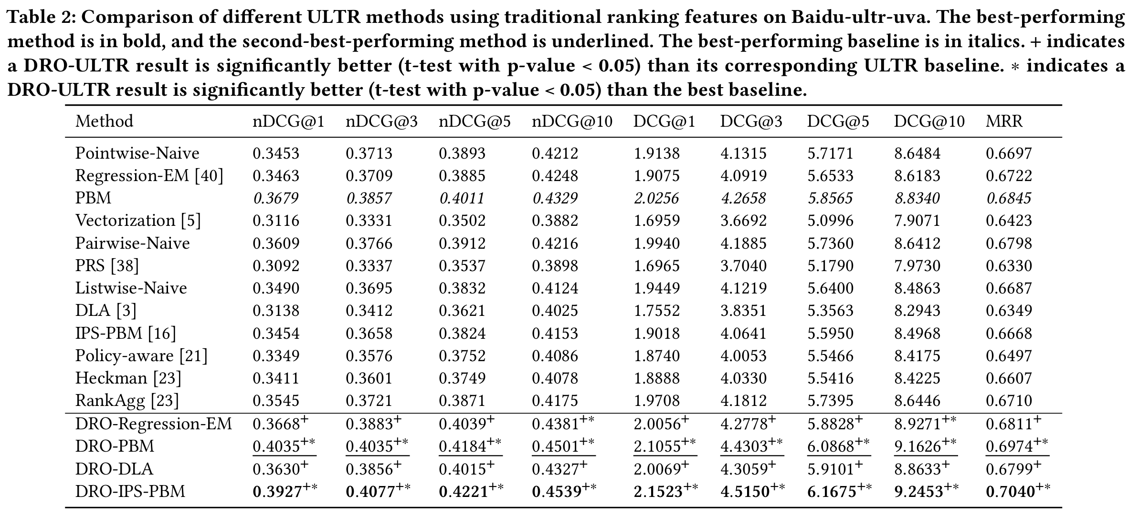
RQ1. How Effective Are the DRO-ULTR Methods on the Real-world Dataset?
All the DRO-ULTR methods outperform their corresponding ULTR baselines in terms of most metrics.
The DRO-IPS-PBM method outperforms all the baselines, including the Policy-aware and RankAgg methods that mitigate the item selection bias.

Slide 17
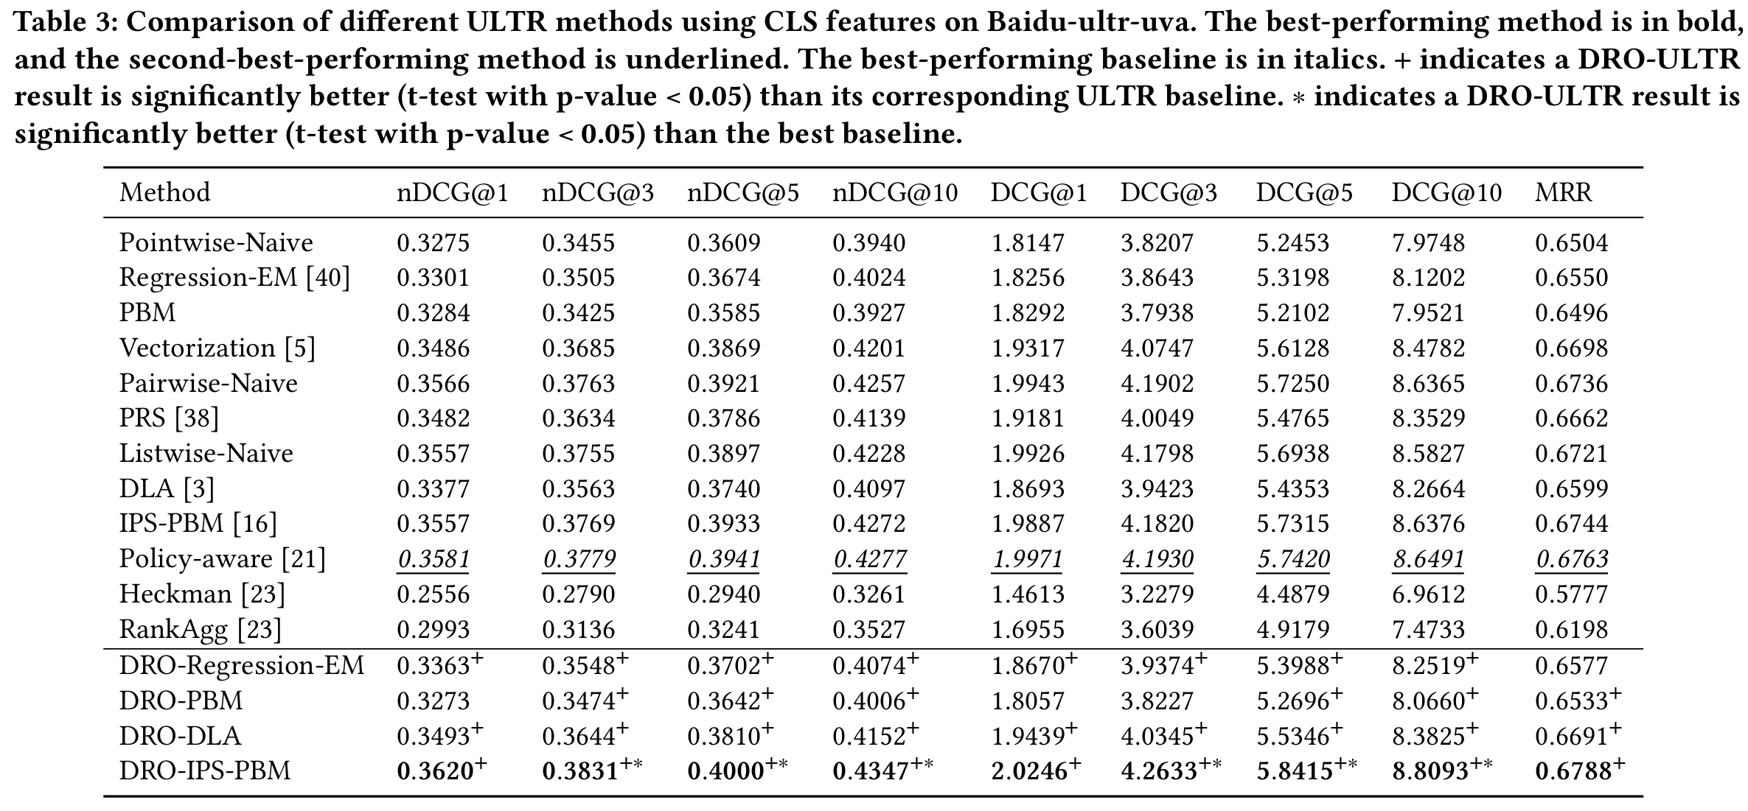
RQ1. How Effective Are the DRO-ULTR Methods on the Real-world Dataset?
DRO-ULTR methods still outperform their corresponding ULTR baselines.
Using traditional ranking features usually yields better performance than using CLS features. Thus, we use the traditional ranking features in the following experiments.

Slide 18
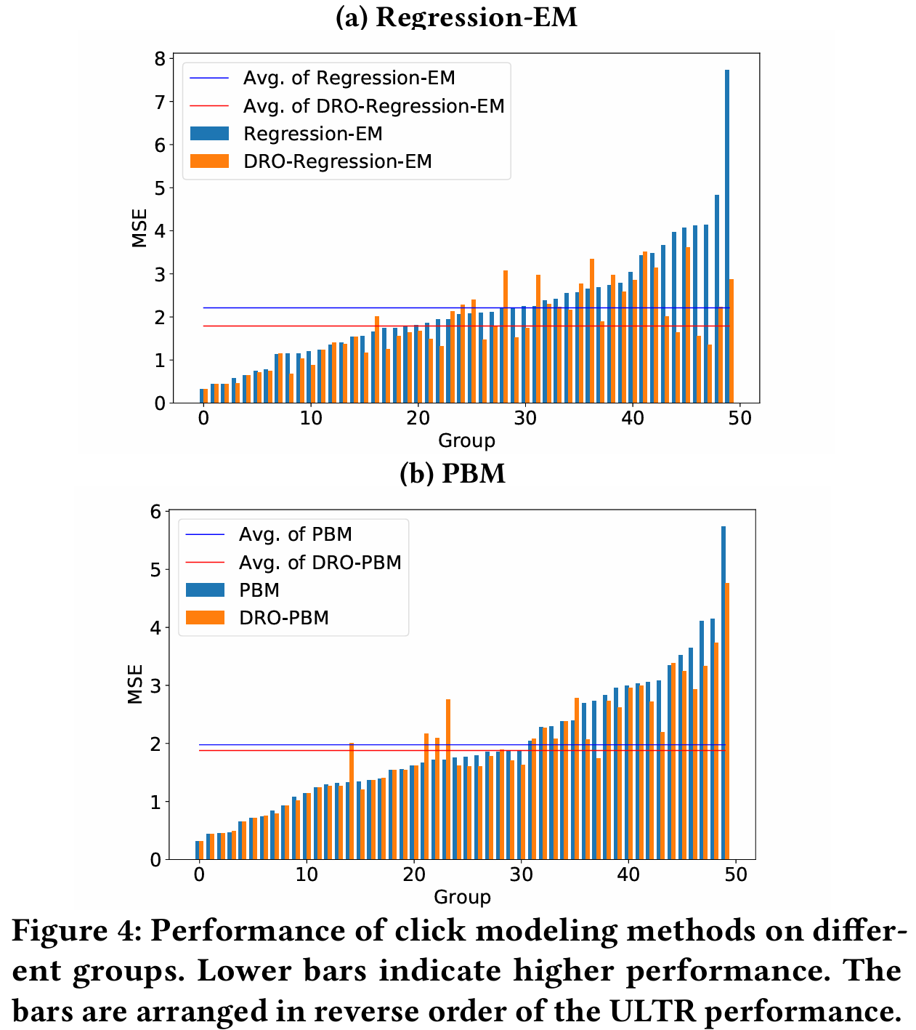
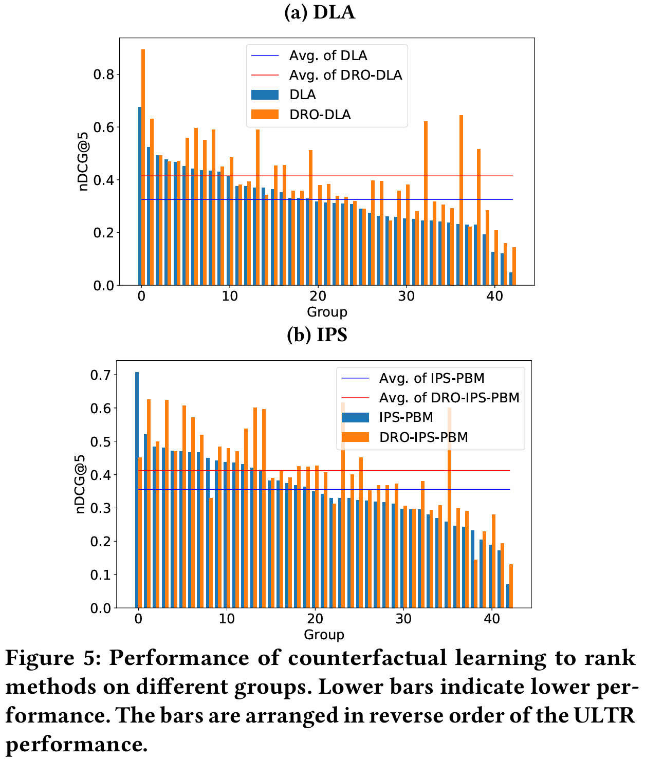
RQ2. How Do the DRO-ULTR Methods Combat Distribution Shifts?
Lower means better
Higher means better
The DRO-ULTR methods improve the worst single-group performance.
On most groups and on average, the DRO-ULTR methods perform better than their corresponding ULTR baselines.

Slide 19
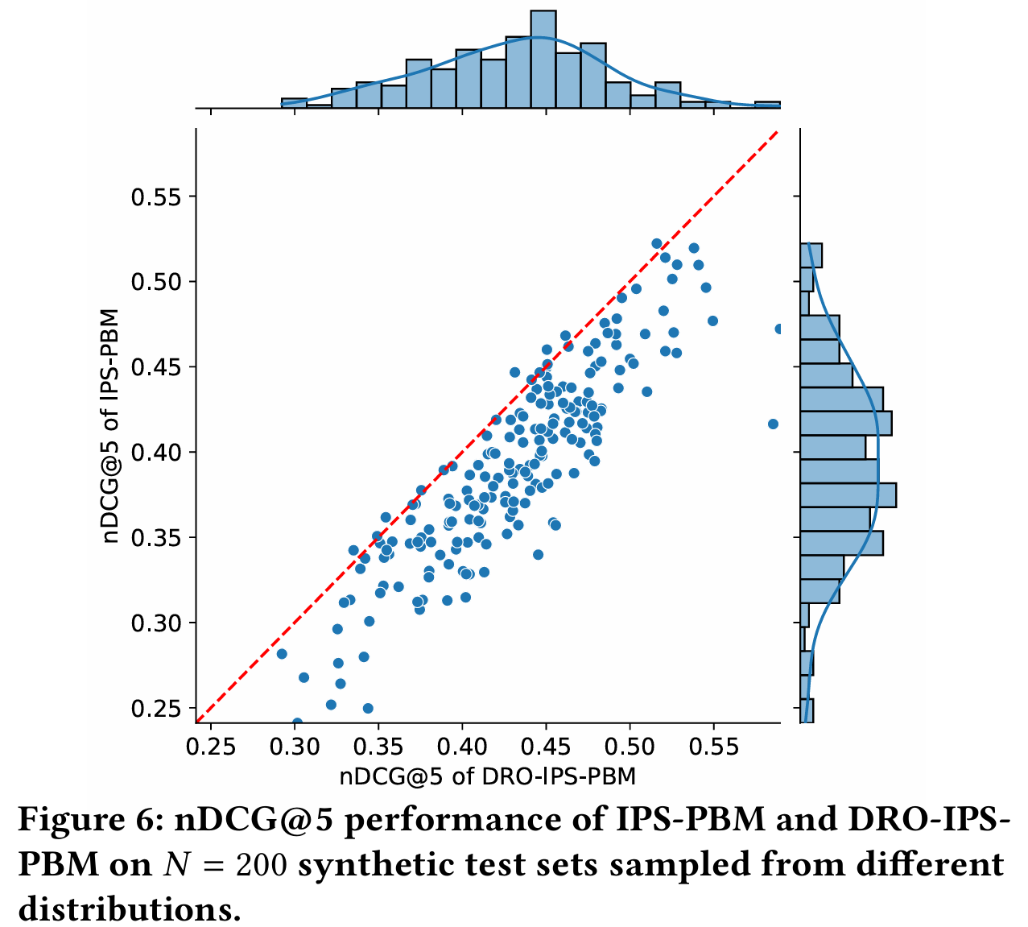
RQ2. How Do the DRO-ULTR Methods Combat Distribution Shifts?
To simulate the situation in which there is an unknown distribution shift in the test time, we generate semi-synthetic test datasets by randomly sampling the test queries.
DRO-IPS-PBM consistently outperforms IPS-PBM in most cases (188 out of 200).

Slide 20
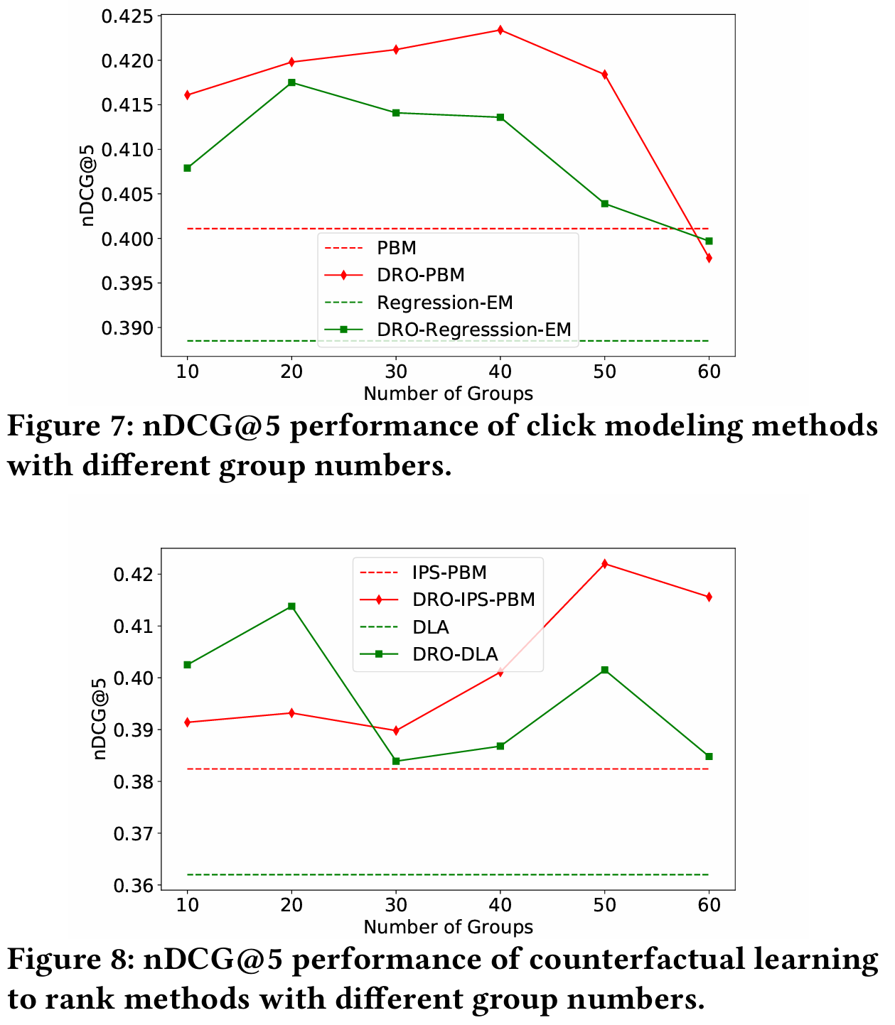
RQ3. How Does the Number of Groups Affect the DRO-ULTR Methods?
All the DRO-ULTR methods outperform their corresponding ULTR baselines with different group numbers varying from 10 to 50.
Dividing the training data into too few or too many groups can hurt the performance of DRO-ULTR methods.
  When the number of groups is too small, it is difficult to distinguish samples with small differences.
  When the number of groups is too large, the clustering result will be sensitive to the outliers in the training data.

Slide 21
Conclusion
In this work, we first validated and analyzed the distribution shift problem in the ULTR scenario with a real-world dataset.
To tackle this problem, we proposed two group-DRO frameworks for the click modeling and counterfactual learning to rank approaches, respectively.
Extensive experiments on the real-world dataset verified the effectiveness of our proposed DRO-ULTR methods in combating distribution shifts.
In the future, it is promising to apply our group-DRO frameworks to other ULTR methods and explore how to group the training samples using deep clustering methods such as Deep Embedded Clustering (DEC).

Slide 22
Thanks
Zechun Niu¹, Lang Mei², Chong Chen², Jiaxin Mao^{1*}
¹Renmin University of China, ²Huawei Cloud BU
niuzechun@ruc.edu.cn, maojiaxin@gmail.com
2025.07

